Slide 1

A Secure Cloud Computing Based Framework for the Blood bank

Slide 2
Presented By:
RANJANA K
Roll No: 31
Presented To:
Guide: Ms. JOICE T

Slide 3
INTRODUCTION
Blood contribute to 7% of total body weight, so to maintain the specific amount of blood in the body is necessary for a human to survive.
A blood Bank can be defined as a bank or storage place where blood is collected, preserved and used whenever needed or demanded. Over the years, blood banking has helped save countless lives. Today, about 13.6 million units of blood are donated per year. About 36,000 units of blood are needed each day. Blood banks can safely store blood donations, and process and screen blood to ensure safety for all. A blood bank ensures that hospitals have a safe, reliable blood supply for patients in need. You can help meet supply demands by scheduling your donation today. Your donation may even help save more than one life.

Slide 4
DESCRIPTION
This project is used to request for blood and also to donate blood. Also it will shows us the nearby hospital for the required blood. The blood bank will make sure to the user that the blood is donated to the blood bank so the user can come and collect it. This project consist of admin, blood bank and user.

Slide 5
RELEVANCE
In many emergency cases (accident, surgeries, etc.) there could be an urgent need for specific blood type then the victim’s family seek for the blood at various places such as hospitals, relatives etc. In hospitals, efficiency of blood or particular group of blood not available that time hospital contact other blood bank or patient’s relative.
In certain situations an individual needs to find the blood by themselves. There comes the use of this project. But for user and medical facility, there is no available media to connect them directly. Here the individual can use this system by themselves.
One of the most important challenges i.e. to provide quick services in the emergency situations.

Slide 6
OBJECTIVE
The main objective of this project is to help users satisfy a blood request made from anywhere and anytime. The system intends to make the blood search process much more efficient and quick

Slide 7
EXISTING SYSTEM
The system that exists today is dependent on paperwork. To donate and receive the blood from the bank, the donor and receiver has to fill the form consisting of the basic details.
There are also certain website for the working of blood bank. The website provides various facilities like searching availability of blood, to connect near blood bank etc.. Latest requests are shown when one opens the website, the recent donors are also referred. It provides details about blood banks all across the nation. The details include the availability of each blood group.

Slide 8
PROPOSED SYSTEM
This project will satisfy the need of blood of an individual in an emergency situation.
The system Consist of
Web Technology for online blood bank
Android Application for users
Cloud Computing for user Data storage
The application will also contain a GPS (Global Positioning System) system to track the location of the nearby blood banks or hospitals.
This system helps to save the time to a great extent. This also helps in correct and quick decision making.

Slide 9
In order to donate blood or request for blood through the application, one has to register himself by providing all the required details. These details must be valid and true so that they can be tracked at the time of emergency. GPS is used in order to locate the blood bank. The proposed system is helps to the patient or seeker to get the nearest blood bank address. Thus the proposed system is completely different from existing system. It is an application which provides interface to the user.
No permanent registration to the website is needed for the requestor, they are only required to provide their basic details and contact information for verification. The purpose of the project is, sometimes patients life is at risk if the appropriate amount of blood is not made available to him whenever needed.
AWS CLOUD – S3
Amazon Simple Storage Service (Amazon S3) is an object storage service that offers industry-leading scalability, data availability, security, and performance. Amazon S3 is an object storage service that stores data as objects within buckets. An object is a file and any metadata that describes the file.
Cloud computing technology is used in this application because cloud computing is the latest and efficient way of server-based computing. Cloud provides good backup recovery, flexibility, and increased security.

Slide 10
MODULES
Login and Logout
The admin and blood bank can login and logout from the website. The user can login and logout from the android application.
Manage Blood Bank
The admin has access to the blood bank. Only Admin can accept the blood bank, i.e. no other blood bank can register. Also admin can blood the required blood bank. Admin can view the details of the customer details and also their feedback and complaints.
Registration
The donor can register using the mobile application and the blood bank can register from the website.
Contact Information
Contact information of blood banks.

Slide 11
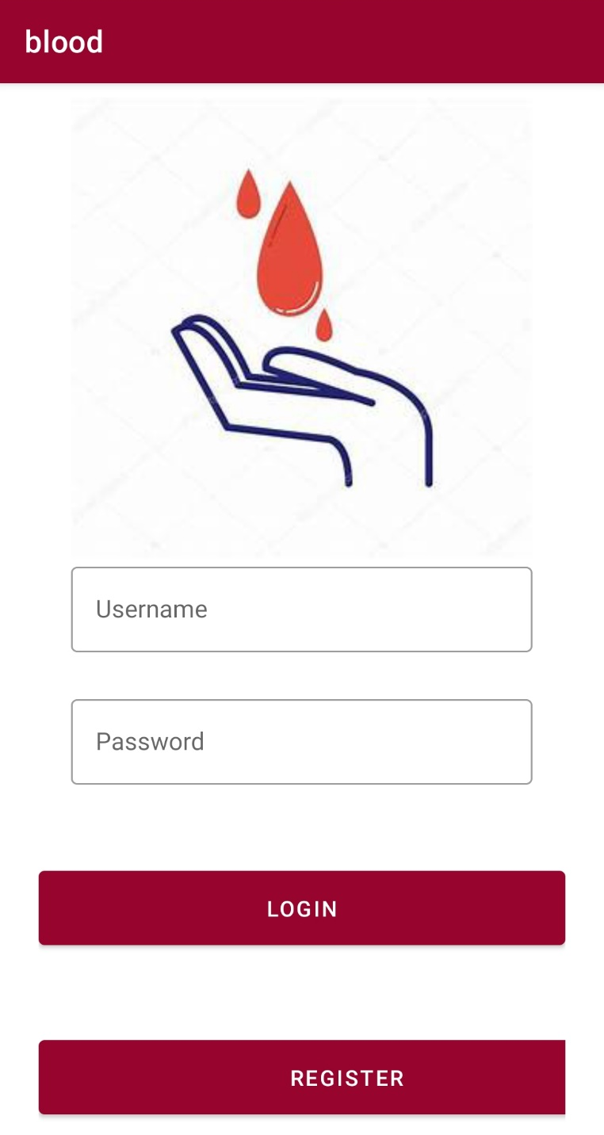
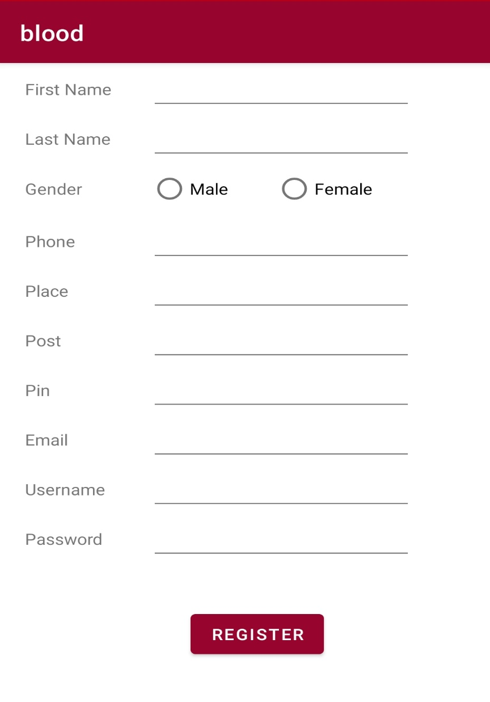
UI DESIGN

Slide 12
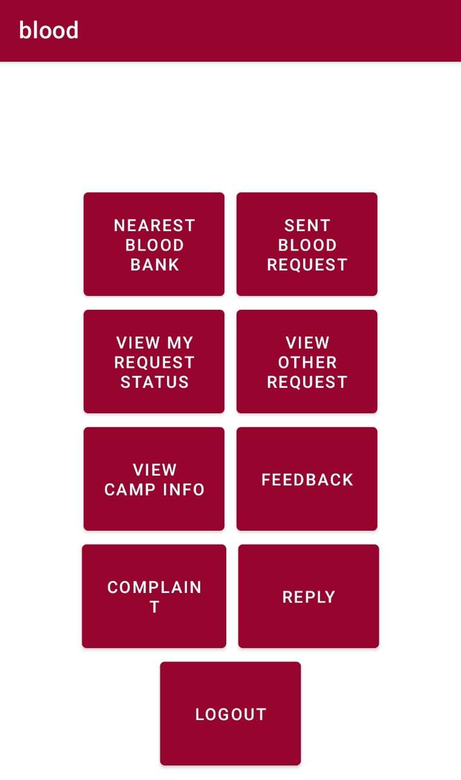

Slide 13
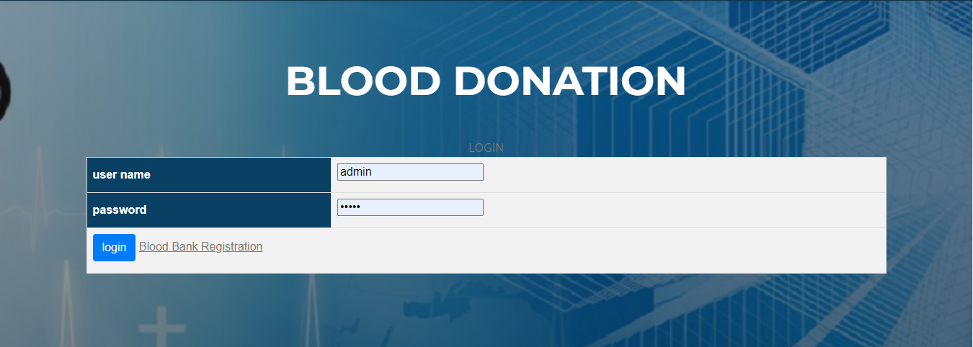

Slide 14


Slide 15


Slide 16
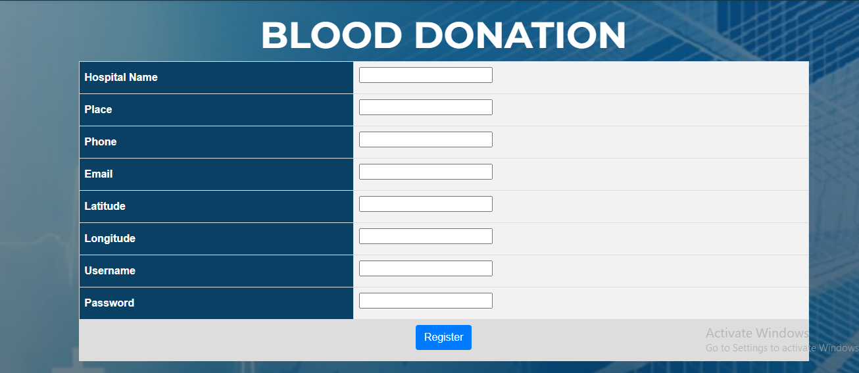

Slide 17
THANK YOU

